Slide 1


Rui Huang
06.01.2024

Slide 2
Outline
Executive Summary
Introduction
Methodology
Results
Conclusion
Appendix
2

Slide 3
Executive Summary
Methodologies
The aim of this study is to identify the determinants of a successful rocket landing. To achieve this objective, the investigation employed the methodologies including:
Data Collection
Data Wrangling
Exploratory Data Analysis (EDA) using SQL, Pandas, Matplotlib
Interactive Visual Analysis using Analytics using Folium, Plotly, Dash
Predictive Analysis using Machine Learning
Summary
The results were being extracted using the following essential component as shown in subsequent slides.
Exploratory Data Analysis (EDA)
Interactive Visual Analysis
Predictive Analysis
3

Slide 4
Introduction
Project background
SpaceX, founded by Elon Musk in 2002, is a California-based aerospace company focused on reducing space transportation costs and advancing space exploration. Notable achievements include operating Falcon 9 and Falcon Heavy rockets, Dragon and Starship spacecraft, and creating the largest-ever satellite constellation called Starlink.
SpaceX has pioneered various milestones, such as the first private liquid-propellant rocket to reach orbit, launching, orbiting, and recovering spacecraft, sending a spacecraft to the International Space Station, and achieving vertical propulsive landings and reusability of orbital rocket boosters.
Problems statement
In this capstone project, our objective is to forecast the successful landing of the Falcon 9 first stage.
SpaceX promotes its Falcon 9 rocket launches on its official platform, pricing them at 62 million dollars, significantly lower than other providers whose costs can go up to 165 million dollars per launch.
The substantial savings SpaceX achieves are largely attributed to the ability to reuse the first stage.
By accurately predicting the first stage landing outcome, we can effectively estimate the overall launch cost. This insight becomes crucial for other companies considering bidding against SpaceX for a rocket launch contract.
4

Slide 5

Section 1
5

Slide 6
Methodology
Executive Summary
Data collection methodology:
Using SpaceX REST API and web scraping techniques
Perform data wrangling
By filtering the data, handling missing values and applying hot encoding
Perform exploratory data analysis (EDA) using visualization and SQL
Perform interactive visual analytics using Folium and Plotly Dash
Perform predictive analysis using classification models
To find best model and parameters
6

Slide 7
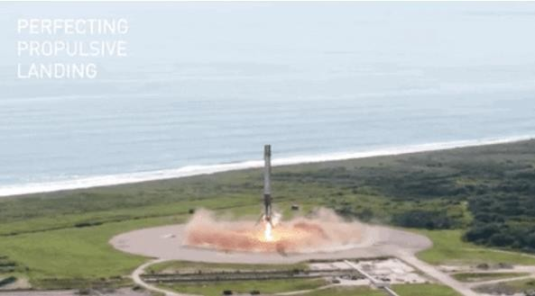
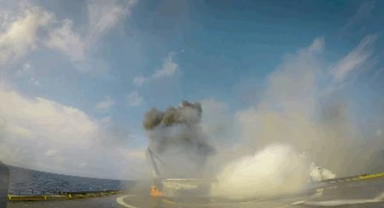
Data Collection
This information may prove valuable if an alternate company intends to bid against SpaceX for a rocket launch. The data will be collected and ensured to be in the correct format from an API.
Web scraping will be performed to collect Falcon 9 historical launch records from Wikipedia page titled "List of Falcon 9 and Falcon Heavy launches."
7

Slide 8
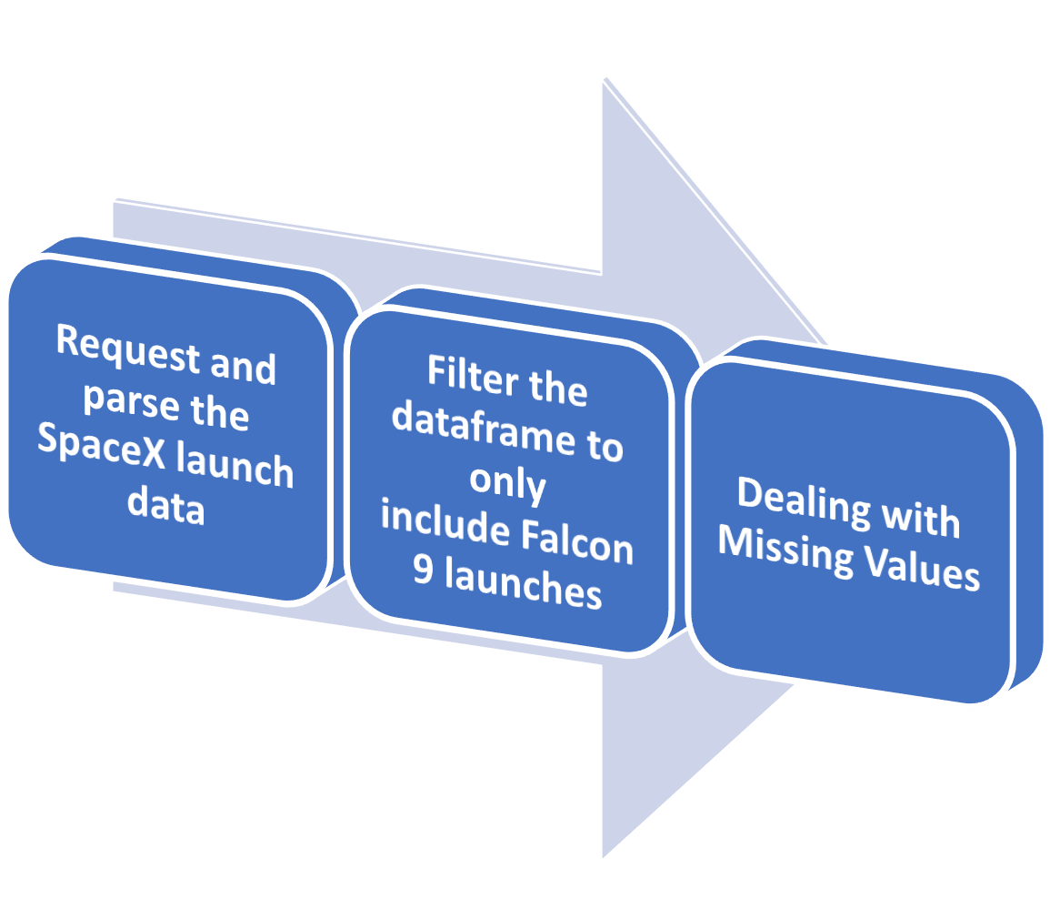
Data Collection – SpaceX API
GitHub Reference: https://github.com/andyngjw/IBM-DataSc- Capstone- SpaceX/blob/main/1_Data%20Collection% 20API.ipynb
CSV file outcome after methodology: https://github.com/andyngjw/IBM-DataSc- Capstone- SpaceX/blob/main/dataset_part_1.csv
8

Slide 9
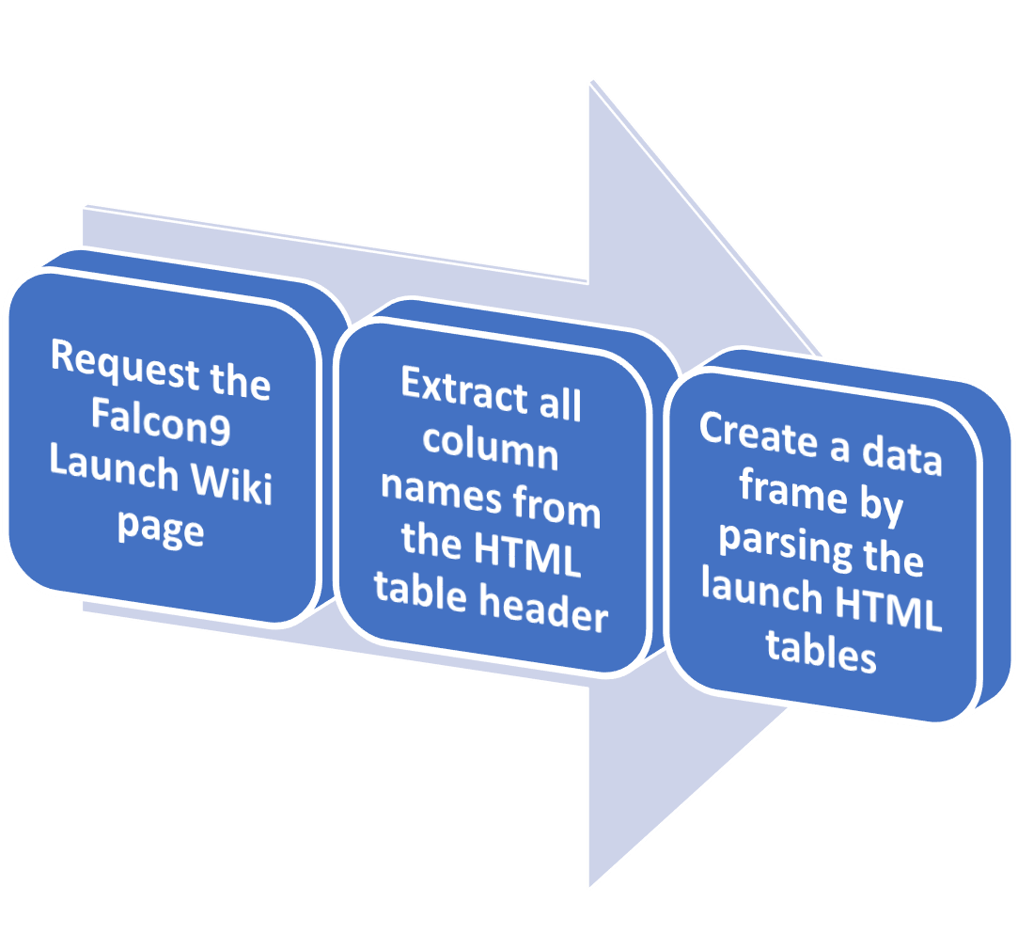
Data Collection - Scraping
GitHub Reference: https://github.com/andyngjw/IBM-DataSc- Capstone- SpaceX/blob/main/2_Webscraping%20.ipy nb
CSV file outcome after methodology: https://github.com/andyngjw/IBM-DataSc- Capstone- SpaceX/blob/main/spacex_web_scraped.c sv
9

Slide 10
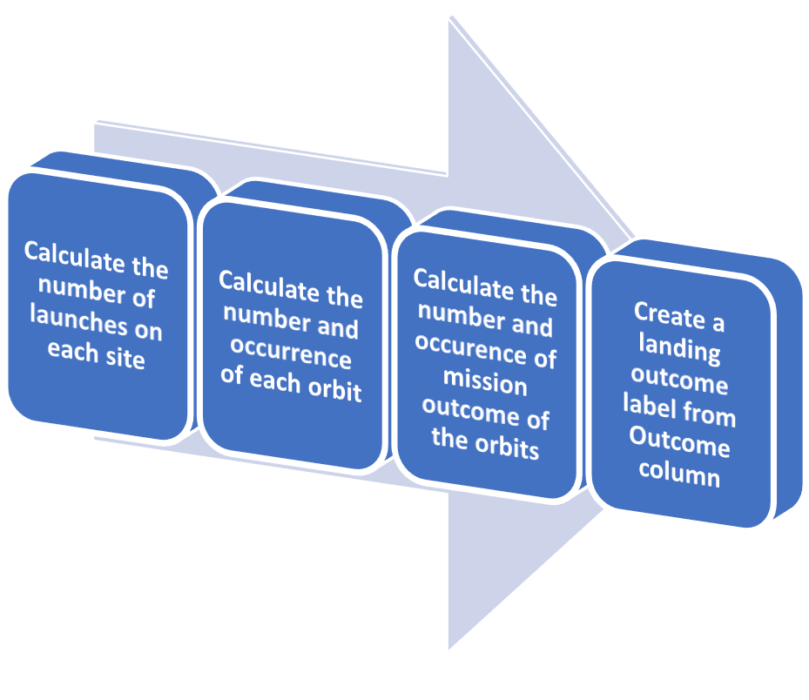
Data Wrangling
Exploratory Data Analysis (EDA) will be performed to identify patterns in the data and determine the label for training supervised models.
Within the dataset, various cases exist where the booster did not land successfully. Instances include attempted landings that failed due to accidents.
The primary focus of this lab will be to transform these outcomes into training labels, where 1 signifies a successfully landed booster, and 0 signifies an unsuccessful landing.
GitHub Reference:
https://github.com/andyngjw/IBM-DataSc-Capstone-SpaceX/blob/main/3_Data%20Wrangling.ipynb
CSV file outcome after methodology:
https://github.com/andyngjw/IBM-DataSc-Capstone-SpaceX/blob/main/dataset_part_2.csv
10

Slide 11
EDA with Data Visualization
The relationship through the chart is visualised
Scatterplots
Barplots
Then, create dummy variables to categorical
column and cast numeric columns to .float
Payload Mass vs Flight Number Launch Site vs Flight Number Launch Site vs Payload Mass Orbit vs Flight Number
Payload vs Orbit
Year vs Average Success Rate
GitHub Reference:
https://github.com/andyngjw/IBM-DataSc-Capstone- SpaceX/blob/main/5_EDA_Data%20Visualisation.ipynb
CSV file outcome after methodology: https://github.com/andyngjw/IBM-DataSc-Capstone- SpaceX/blob/main/dataset_part_3.csv

Slide 12
EDA with SQL
Queries
Names of the unique launch sites in the space mission;
Top 5 launch sites whose name begin with the string 'CCA’;
Total payload mass carried by boosters launched by NASA (CRS);
Average payload mass carried by booster version F9 v1.1;
Date when the first successful landing outcome in ground pad was achieved;
Names of the boosters which have success in drone ship and have payload mass between 4000 and 6000 kg;
Total number of successful and failure mission outcomes;
Names of the booster versions which have carried the maximum payload mass;
Failed landing outcomes in drone ship, their booster versions, and launch site names for in year 2015;
Rank of the count of landing outcomes (such as Failure (drone ship) or Success (ground pad)) between the
date 2010-06-04 and 2017-03-20.
GitHub Reference:
https://github.com/andyngjw/IBM-DataSc-Capstone-SpaceX/blob/main/4_EDA_SQLite.ipynb

Slide 13
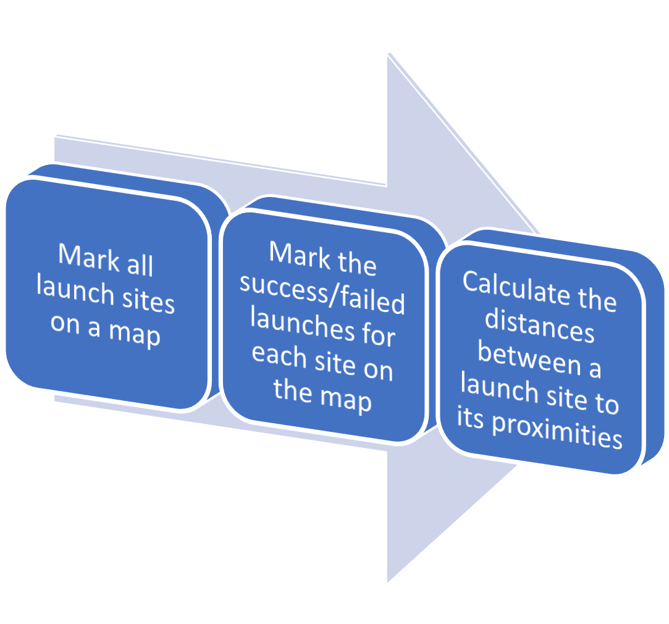
Build an Interactive Map with Folium
The launch success rate may depend on location and proximities of a launch site, i.e., the initial position of rocket trajectories.
Markers, circles, lines and marker clusters were used
with Folium Maps
Markers: points
Circles: highlighted areas around specific coordinates
Lines: distances between two coordinates
Marker clusters: groups of events in each coordinate
GitHub Reference:
https://github.com/andyngjw/IBM-DataSc-Capstone- SpaceX/blob/main/6_Data%20Visulisation_Folium.ipynb
13

Slide 14
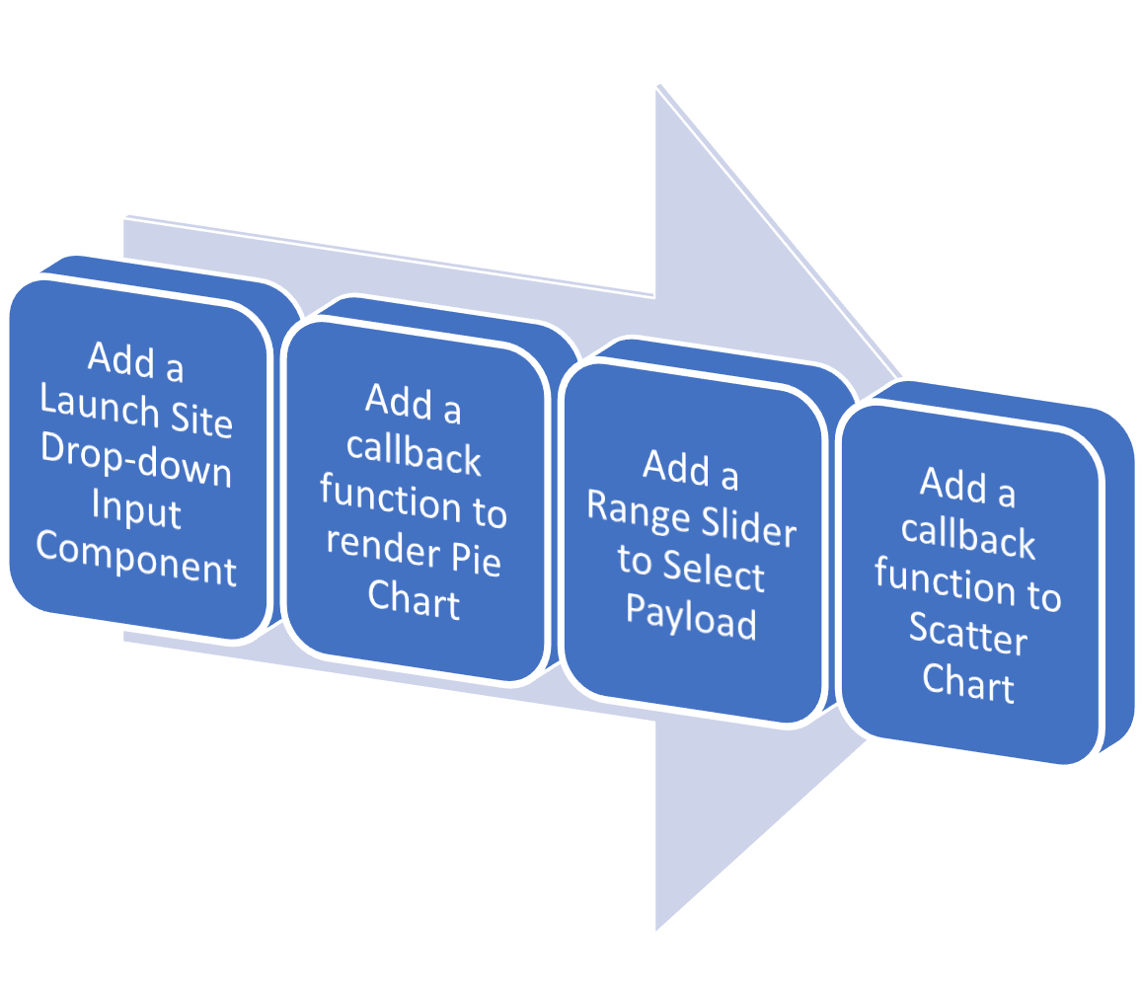
Build a Dashboard with Plotly Dash
A Plotly Dash application will be built for users to engage in interactive visual analytics on SpaceX launch data in real-time.
The dashboard application contains input
components, including:
A dropdown list to interact with a pie chart and a scatter point chart
A range slider to interact with a scatter point chart
GitHub Reference:
https://github.com/andyngjw/IBM-DataSc-Capstone- SpaceX/blob/main/7_Data%20Visulisation_Plotly_Dash.py

Slide 15
Predictive Analysis (Classification)
Exploratory Data Analysis will be performed
Create a column for the class
Standardize the data
Split into training data and test data
Logistics regression
Vector Support Machine
Then, the method which performs best using test data is determined
by finding the best Hyperparameter for SVM, Classification Trees and Logistic Regression
Decision Tree
k Nearest Neighbours
GitHub Reference: https://github.com/andyngjw/IBM-DataSc-Capstone- SpaceX/blob/main/8_Machine%20Learning.ipynb

Slide 16
Results
Exploratory data analysis results through graphs
CCAFS SLC 40 has the highest success rate, compared to KSC LC 39A and VAFB SLC 4E
The higher the payload mass, the higher the success rate
ES-L1, GEO, HEO, and SSO orbit has 100% success rate
Some orbits has higher success rate, but the total flight number in those orbits is less
The payload does not show significant difference compared to orbit type
The success rate shows improvement throughout the year starting from 2013 to 2020
Interactive analytics results
All launch sites were built in seashore area, and far away from the city, highway, and railway
This is to ensure the safety of the citizens, and avoid causing further damage when the landing is unsuccessful
KSC LC-39A has the highest success rate (41.2%), CCAFS LC-40 has the lowest success rate (14.4%)
Predictive analysis results
The Decision Tree Classifier shows the highest accuracy as it shows the highest value of true positive and true negative values

Slide 17

Section 2

Slide 18
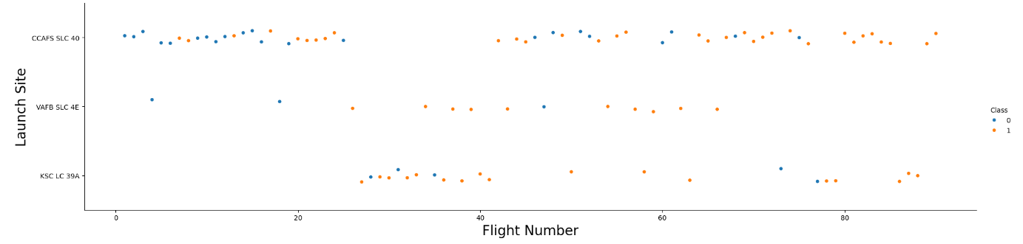
Flight Number vs. Launch Site
Explanation:
Blue dots represents the landing is not successful, Orange dots represents successful landing
The higher the flight number, the later the flight is launched
Results show the higher the flight number, the higher the success rate (More orange dots appear)
CCAFS SLC 40 has the highest success rate, compared to KSC LC 39A and VAFB SLC 4E
It infers the success landing rate is improved over time

Slide 19
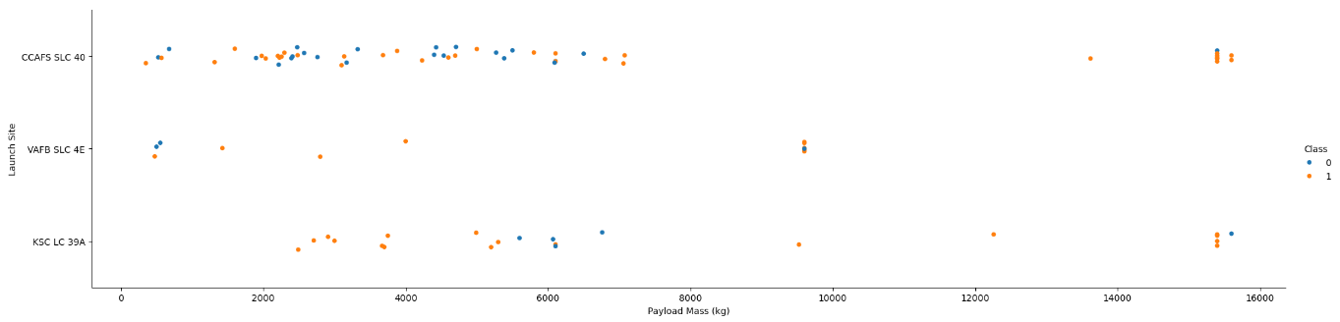
Payload vs. Launch Site
Explanation:
Results show the higher the payload mass, the higher the success rate
The landing is almost successful when the payload mass is more than 7000 kg.
The maximum payload mass for VAFB SLC 4E is about 9000 kg, while for CCAFS SLC 40 and KSC LC 35A, the maximum payload mass can reach to around 15000 kg.

Slide 20
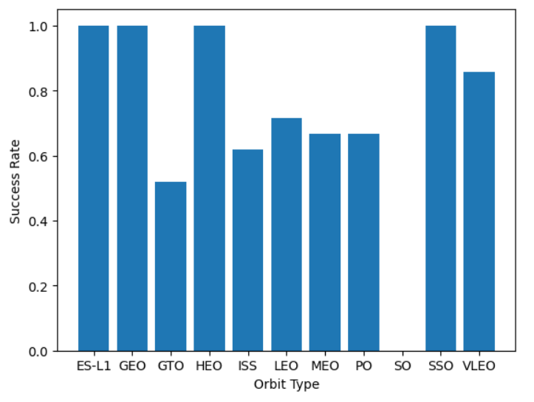
Success Rate vs. Orbit Type
Explanation:
100% success rate: ES-L1, GEO, HEO, and SSO
>80% success rate: VLEO
Lowest success rate (0%): SO

Slide 21
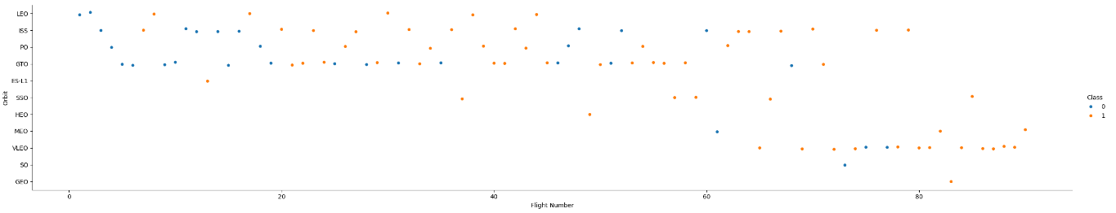
Flight Number vs. Orbit Type
Explanation:
Some orbits has higher success rate, but the total flight number in those orbits is less
It could be observed that the later the flight, the success rate is improved
VLEO has a higher frequency in late stage, with high rate of success

Slide 22
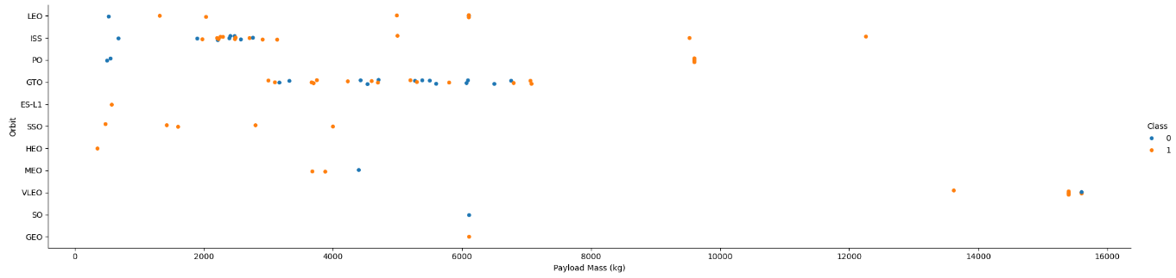
Payload vs. Orbit Type
Explanation:
The payload does not show significant difference compared to orbit type
The higher payload mass brings higher success rate in LEO and ISS

Slide 23
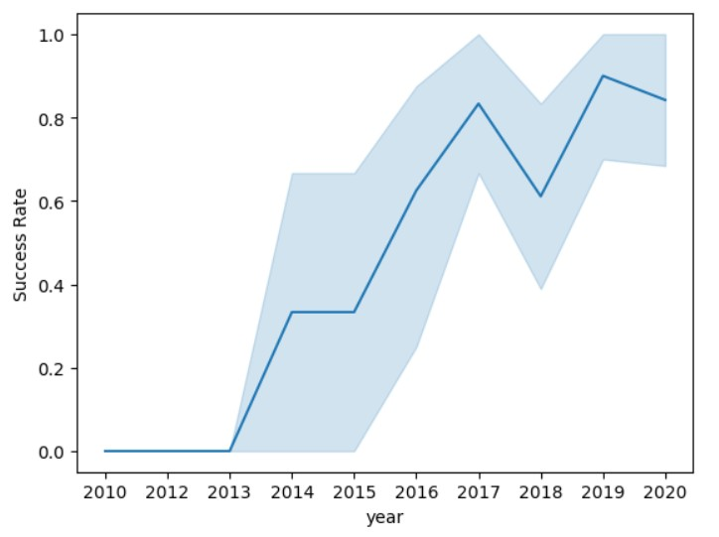
Launch Success Yearly Trend
Explanation:
The success rate shows improvement throughout the year starting from 2013 to 2020
The success rate from 2010 to 2013 remains 0%, it could be inferred that the launching is still in development

Slide 24
All Launch Site Names
Launch Site
CCAFS LC-40
VAFB SLC-4E
KSC LC-39A
CCAFS SLC-40
Query:
%sql SELECT DISTINCT(LAUNCH_SITE) FROM SPACEXTBL;

Slide 25
Launch Site Names Begin with 'CCA'
Date | Time (UTC) | Booster_Versio n | Launch_Site | Payload | PAYLOAD_MAS S KG_ | Orbit | Customer | Mission_Outco me | Landing_Outco me
2010-06-04 | 18:45:00 | F9 v1.0 B0003 | CCAFS LC-40 | Dragon Spacecraft Qualification Unit | 0 | LEO | SpaceX | Success | Failure (parachute)
2010-12-08 | 15:43:00 | F9 v1.0 B0004 | CCAFS LC-40 | Dragon demo flight C1, two CubeSats, barrel of Brouere cheese | 0 | LEO (ISS) | NASA (COTS) NRO | Success | Failure (parachute)
2012-05-22 | 7:44:00 | F9 v1.0 B0005 | CCAFS LC-40 | Dragon demo flight C2 | 525 | LEO (ISS) | NASA (COTS) | Success | No attempt
2012-10-08 | 0:35:00 | F9 v1.0 B0006 | CCAFS LC-40 | SpaceX CRS-1 | 500 | LEO (ISS) | NASA (CRS) | Success | No attempt
2013-03-01 | 15:10:00 | F9 v1.0 B0007 | CCAFS LC-40 | SpaceX CRS-2 | 677 | LEO (ISS) | NASA (CRS) | Success | No attempt
Query:
%sql SELECT * FROM SPACEXTBL WHERE LAUNCH_SITE LIKE 'CCA%' LIMIT 5;
25
**Only first 5 rows are shown in this query, to show the Launch Site ‘CCAFS-LC 40’

Slide 26
Total Payload Mass
Total_Payload_Mass_kg
45596
Query:
%sql SELECT SUM(PAYLOAD_MASS KG_) AS Total_Payload_Mass_kg FROM SPACEXTBL WHERE CUSTOMER = 'NASA (CRS)';

Slide 27
Average Payload Mass by F9 v1.1
AVG(PAYLOAD_MASS KG_)
2928.4
Query:
%sql SELECT AVG(PAYLOAD_MASS KG_) FROM SPACEXTBL WHERE BOOSTER_VERSION = 'F9 v1.1';

Slide 28
First Successful Ground Landing Date
MIN(DATE)
2015-12-22
Query:
%sql SELECT MIN(DATE) \ FROM SPACEXTBL \
WHERE Landing_Outcome = 'Success (ground pad)'

Slide 29
Successful Drone Ship Landing with Payload between 4000 and 6000
Payload
JCSAT-14
JCSAT-16
SES-10
SES-11 / EchoStar 105
Query:
%sql SELECT PAYLOAD \ FROM SPACEXTBL \
WHERE Landing_Outcome = 'Success (drone ship)' \ AND PAYLOAD_MASS KG_ BETWEEN 4000 AND 6000;

Slide 30
Total Number of Successful and Failure Mission Outcomes
Mission_Outcome | total_number
Failure (in flight) | 1
Success | 98
Success | 1
Success (payload status unclear) | 1
Query:
%sql SELECT MISSION_OUTCOME, COUNT(*) as total_number \ FROM SPACEXTBL \
GROUP BY MISSION_OUTCOME;

Slide 31
Boosters Carried Maximum Payload
Booster_Version
F9 B5 B1048.4
F9 B5 B1049.4
F9 B5 B1051.3
F9 B5 B1056.4
F9 B5 B1048.5
F9 B5 B1051.4
F9 B5 B1049.5
F9 B5 B1060.2
F9 B5 B1058.3
F9 B5 B1051.6
F9 B5 B1060.3
F9 B5 B1049.7
Query:
%sql SELECT BOOSTER_VERSION \ FROM SPACEXTBL \
WHERE PAYLOAD_MASS KG_ = (SELECT MAX(PAYLOAD_MASS KG_) FROM SPACEXTBL);

Slide 32
2015 Launch Records
month | Date | Booster_Version | Launch_Site | Landing_Outcome
01 | 2015-01-10 | F9 v1.1 B1012 | CCAFS LC-40 | Failure (drone ship)
04 | 2015-04-14 | F9 v1.1 B1015 | CCAFS LC-40 | Failure (drone ship)
Query:
%sql SELECT substr(Date,6,2) AS month, DATE,BOOSTER_VERSION, LAUNCH_SITE, [Landing_Outcome] \ FROM SPACEXTBL \
WHERE [Landing_Outcome] = 'Failure (drone ship)' and substr(Date,0,5)='2015’;
substr(Date,6,2) AS month → This extracts a substring from the "Date" column starting at the 6th character and taking 2
characters. It is used to get the month part of the date.
substr(Date,0,5) ='2015’ → This extracts a substring from the "Date" column starting at the 0th character (the beginning) and taking 5 characters. It is used to compare the first 5 characters of the date to check if they are equal to '2015'. This condition filters the results to include only those records where the year in the "Date" column is '2015’.

Slide 33
Rank Landing Outcomes Between 2010-06-04 and 2017-03-20
Landing_Outcome | count_outcomes
No attempt | 10
Success (drone ship) | 5
Failure (drone ship) | 5
Success (ground pad) | 3
Controlled (ocean) | 3
Uncontrolled (ocean) | 2
Failure (parachute) | 2
Precluded (drone ship) | 1
Query:
%sql SELECT Landing_Outcome, COUNT(*) as count_outcomes FROM SPACEXTBL \
WHERE DATE between '2010-06-04' and '2017-03-20' \
GROUP BY Landing_Outcome \ ORDER BY count_outcomes DESC;
33

Slide 34

Section 3

Slide 35
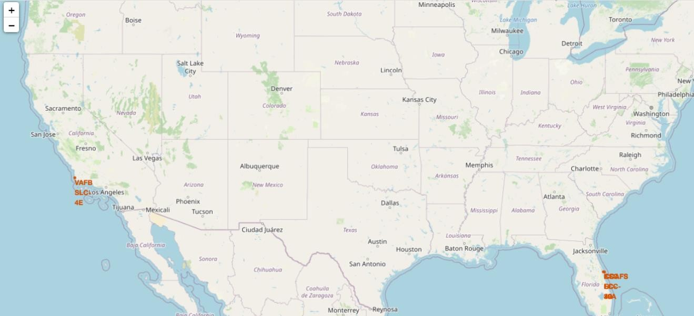
Launch Sites
35
• All launch sites were in seashore area → for plannings if the landing is not successful

Slide 36
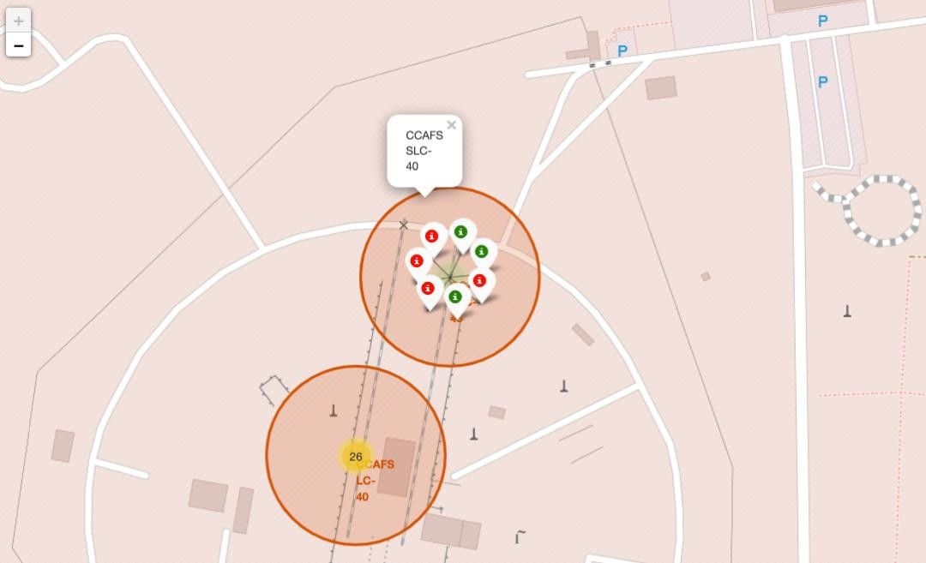
Launch Outcomes by Site
Showing one of the marker clusters in CCAFS SLC-20, it could be observed that the success rate of this site is 3 per 7.
Another site could be analysed for the outcome through click the centre of the site, e.g. 26.

Slide 37
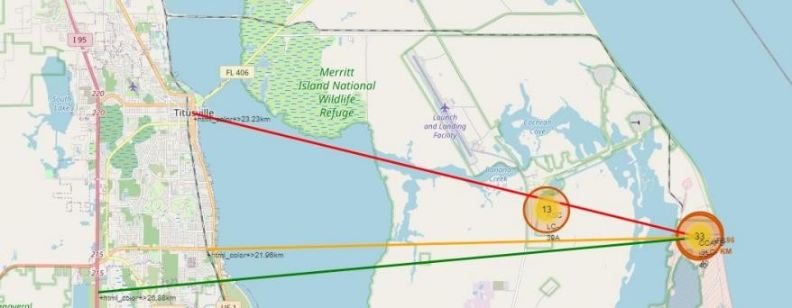
Distance to Proximities
Example: CCAFS SLC-20
It is built very near to the coastline, while far away from the city, highway, and railway
To ensure the safety of the citizens, and avoid causing further damage when the landing is unsuccessful

Slide 38

Section 4

Slide 39
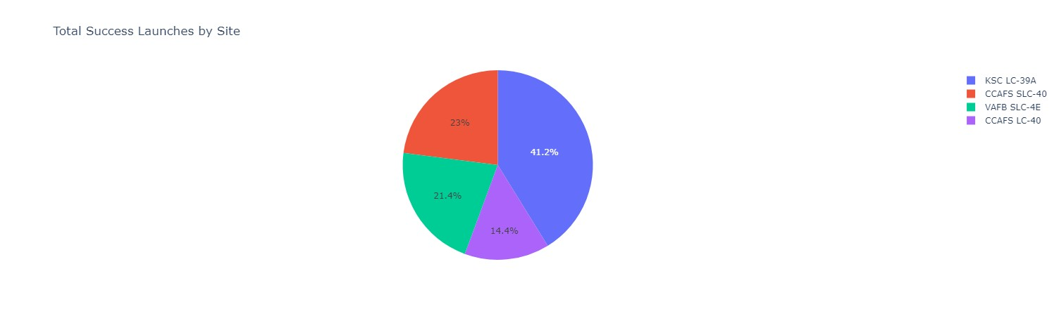
Total Success Launches by Site
By comparing the total success launches by site,
KSC LC-39A has the highest success rate (41.2%)
CCAFS LC-40 has the lowest success rate (14.4%)
39

Slide 40
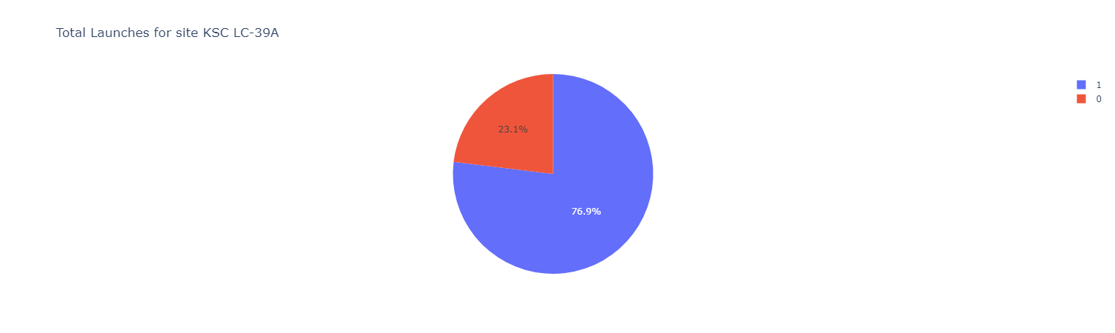
Launch Success Analysis for KSC LC-39A
In total success launches by site KSC LC-39A,
The success rate reaches 76.9%
40

Slide 41
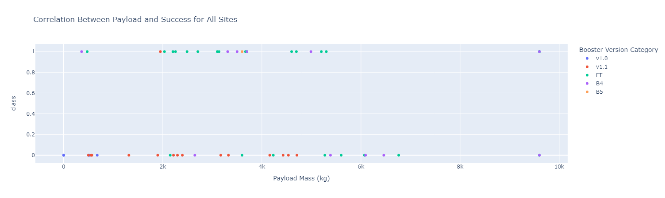
Payload vs Success Rate
In the graph, 1 = success, 0 = not success
In successful launches, the payload mass is normally between 2000kg and 6000kg
In successful launches, FT Booster has the highest prevalence, showing the success rate is the highest when ⁴¹
FT Booster is used

Slide 42

Section 5

Slide 43
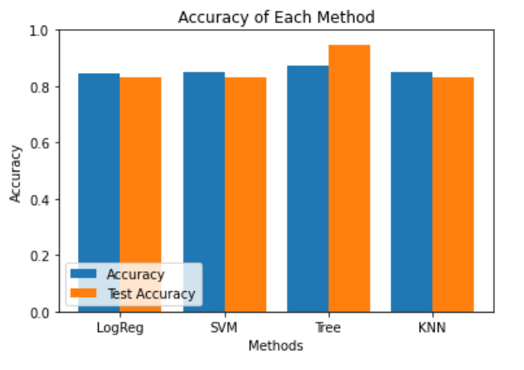
Classification Accuracy
Through the accuracy of the models, the decision tree model has the highest values among others.
The graph is plotted based on the table below, by showing accuracy score using each ML method:
 | ML Method | Accuracy Score (%)
0 | Support Vector Machine | 83.333333
1 | Logistic Regression | 83.333333
2 | K Nearest Neighbour | 94.444444
3 | Decision Tree | 83.333333

Slide 44
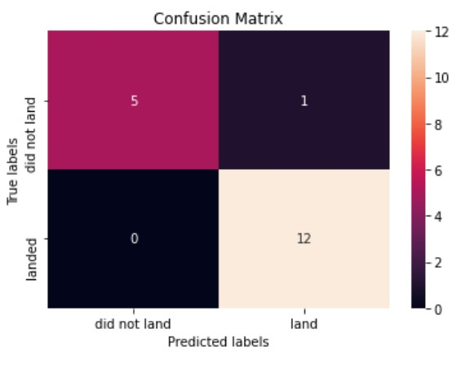
Confusion Matrix
Example: Decision Tree Classifier
The Decision Tree Classifier shows the highest accuracy as it shows the highest value of true positive and true negative values.
The false positive (Type I) is 1, while the false negative (Type II) is 0.

Slide 45
Conclusions
The analysis reveals that CCAFS SLC 40 boasts the highest success rate among launch sites, and
there is a positive correlation between payload mass and mission success.
Certain orbits consistently achieve a 100% success rate, but some high-performing orbits have fewer overall flights.
Over the years, there is a noticeable improvement in success rates. Interactive analytics highlight strategic launch site locations for safety, with KSC LC-39A having the highest success rate and CCAFS LC-40 the lowest.
The Decision Tree Classifier stands out in predictive analysis, demonstrating the highest accuracy.
Overall, the findings provide insights into the factors influencing space mission success,
encompassing launch site performance, payload characteristics, and orbital considerations.

Slide 46
Appendix
GitHub Project Repository!
https://github.com/rhuang7/DataScience_IBM

Slide 47


